Slide 1

GREAT RIVERS
Chapter Overview
‹#›

Slide 2
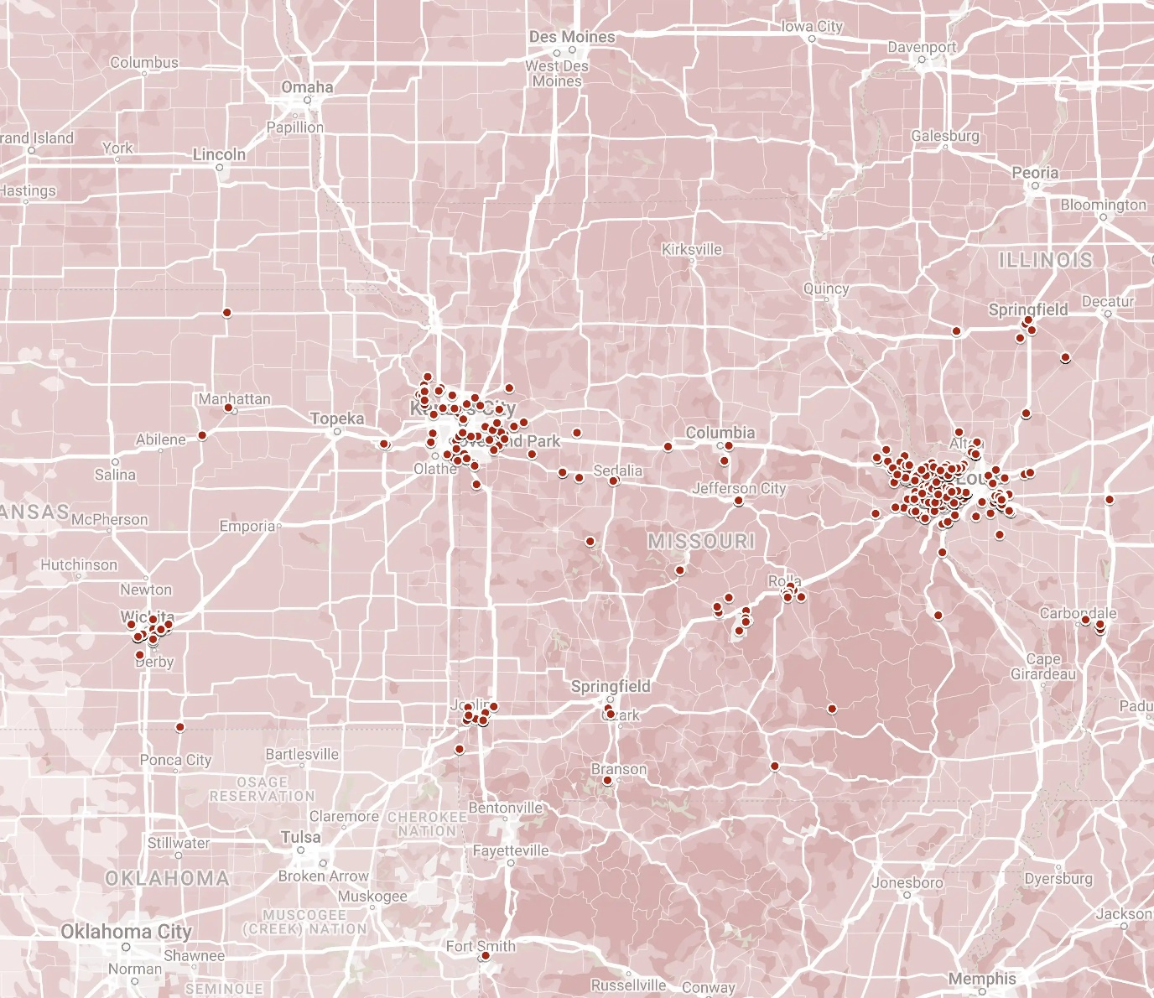
GEOGRAPHY
Roughly demarcated by the Mississippi, Missouri, and Arkansas Rivers
Approximately 1,200 members
Active member hubs in St. Louis and Kansas City
Chapter Members
‹#›
Notes:
Although geographically large, the Great Rivers Chapter is most active in St Louis. Listed in its roster are nearly 1200 members of which a tenth are government and military. First established in the 1920’s, the “St. Louis Chapter” covered the aircraft industries of the day that supported the Army. That is still at the core, but the chapter represents many other defense products relevant to today's defense needs. With regards to the relevance of the region to national strength, geography plays a vital role – the huge interior waterways that can transport the nation’s immense agricultural and manufacturing production. And that reason is the logic behind the 2014 renaming of the chapter. According to the U.S. Army Corps of Engineers, the Mississippi River alone annually carries more than 500 million tons of imports, exports, and domestic freight. It is fed by the Illinois, Missouri and Ohio Rivers in the Great Rivers footprint. By including the Red River and Tombigbee River systems in our sister chapters’ footprint, a very large portion of the nation’s area is served.

Slide 3
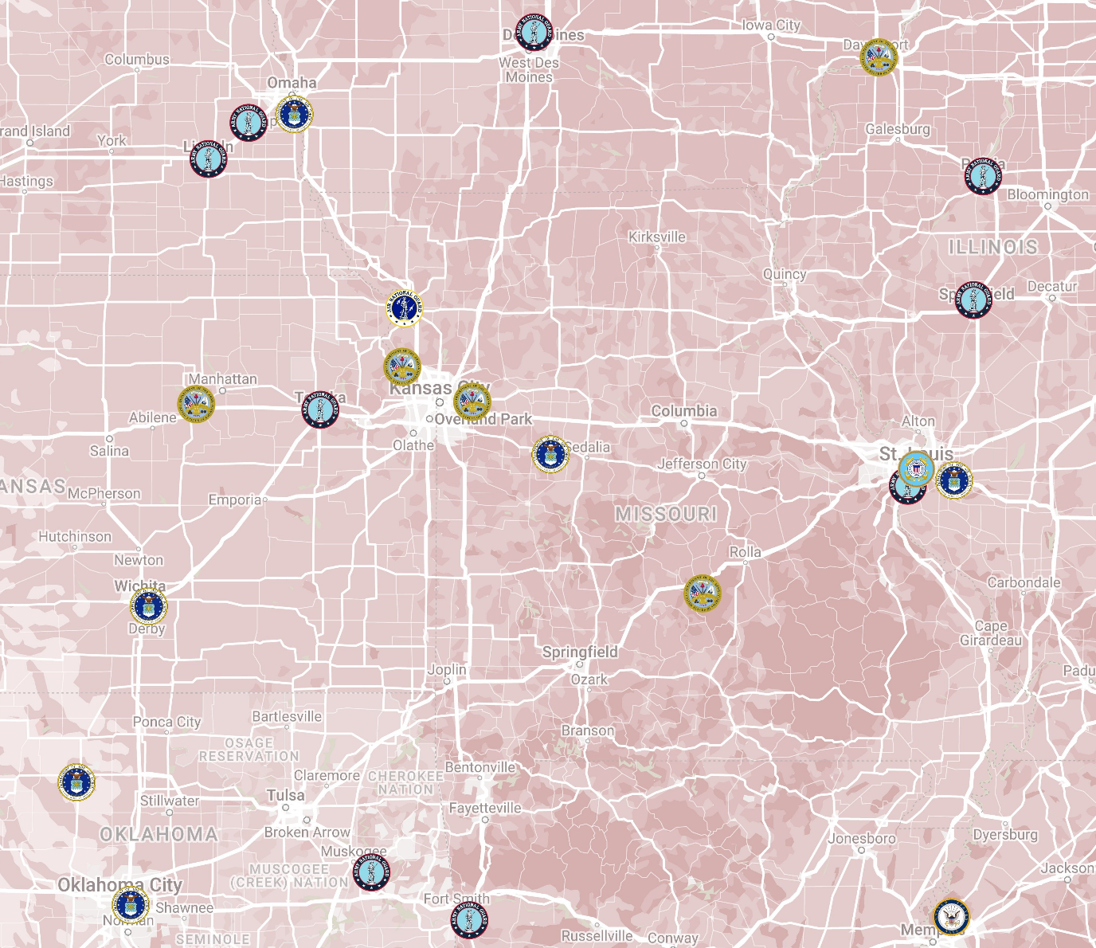
SIGNIFICANCE
Aerospace hubs in St. Louis and Wichita
Vital for defense manufacturing, research, and intelligence.
Key DoD organizations include Army, Air Force, Transportation Command, National Geospatial-Intelligence Agency, Strategic Command, and many others.
Leading munitions producers, nuclear deterrence assets, and key technology developers for intelligence and future warfare.
Offutt Air Force Base
Fort Leavenworth
Lake City Army Ammunition Plant
Fort Riley
Whiteman Air Force Base
Scott Air Force Base
McConnell Air Force Base
Fort Leonard Wood
Vance Air Force Base
Tinker Air Force Base
‹#›
Notes:
Regional aerospace hubs in St. Louis and Wichita
Munitions industry of western Illinois and Missouri, where most of the ammunition (5.56 mm, 7.62 mm, .50 caliber, and 20 mm) used by our military are produced, as well as percussion and electric primers and pyrotechnics
Outside the gates of our bases, defense and national security research is expanding and analysis/ information support companies are thriving.
Work in KC area supporting the nation's nuclear deterrence or the significance of the region to the nation's cyber resilience
Open conflict in Europe as well as the nature of strategic competition and nuclear deterrence have elevated the importance of the DoD organizations in the Great Rivers region. United States Transportation Command, headquartered at Scott Air Force Base, Illinois is the most vital enabling component to the nation's ability to project power, deliver aid, and respond to contingencies. The Air Force Global Strike Command's B-2 Stealth Bombers at Whiteman Air Force Base, Missouri along with the entire nation's strategic assets await orders from United States Strategic Command, which is headquartered to our north in Omaha, Nebraska. The National Geospatial-Intelligence Agency's new facility, opening 2025, in downtown St. Louis will be the center point for the Pentagon's most advanced artificial intelligence effort, Project Maven. Each of one these vital national defense customers rely on a vast ecosystem of industry suppliers, operators, and partners. The Great Rivers Chapter represents this regional ecosystem within the broader national defense industrial base.

Slide 4

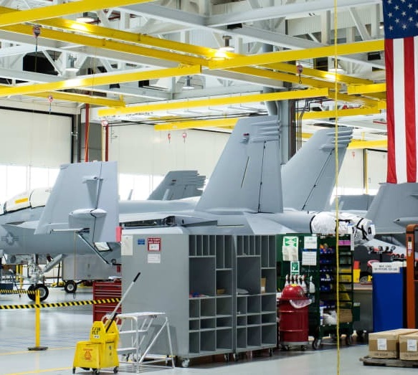
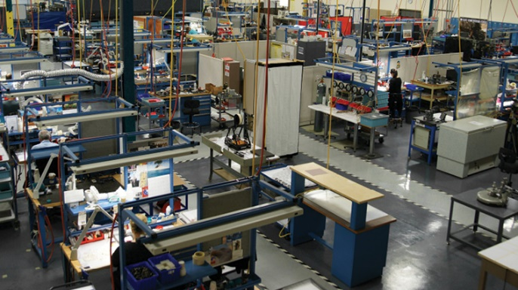

CHAPTER VALUE
Chapter focused on manufacturing, research, small business, and supply chain issues affecting the regional defense industrial base.
Corporate member-only and by-invitation events with DoD officials.
Collaborate, identify partners, and collect business intelligence in chapter meetings.
Relay concerns and information to NDIA-national to give voice to legislative issues.
‹#›

Slide 5
CHAPTER EVENTS
January | February | March | April | May | June
Great Rivers Working Group
Annual Gathering
KC Networking
Event
EXAMPLE
July | August | September | October | November | December
STL Networking Event
NDAA Draft Review
‹#›

Slide 6
CHAPTER BOARD
Steve Tupper
Tim Comerford
Anne Harper
Chris Hollars
Charles Bauer
Josh White
‹#›

Slide 7
GREAT RIVERS

